Slide 1
How can we increase revenue
from
Catch the Pink Flamingo?
Paulo Cardoso

Slide 2
Problem Statement
How can we use the following data sets to understand options for increasing revenue from game players?
flamingo-data
combined-dala
chat-data
Notes:
In order to understand the game and, the user behaviour 3 sets of CSV files were made available.
The first one flamingo-data is composed of 8 datasets in CSV format that represents the logs of a simulated game data, this data was used on the data exploration performed on Splunk;
The second combined-dala is composed of a single in CSV format that represents the combination of several datasets and it was used to identify and classify the users based on spend behavior in the game;
The third chat-data is composed of 6 datasets in CSV format that represents the simulated chat between the players and it was used on the creation of the graph analysis.

Slide 3
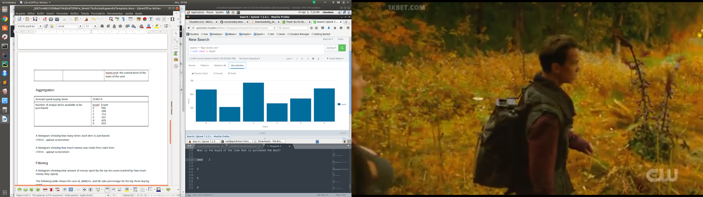
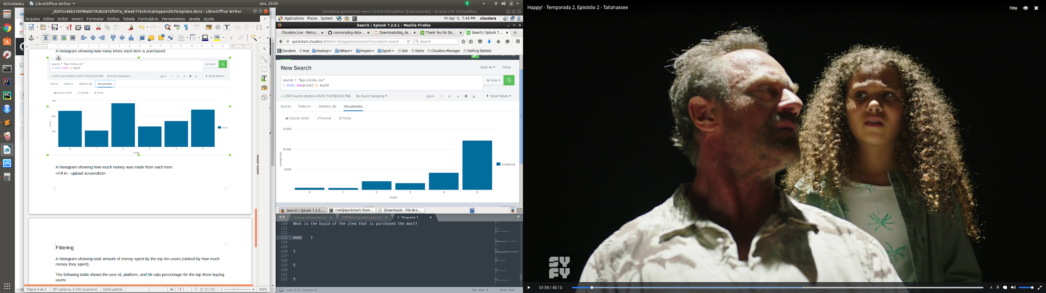
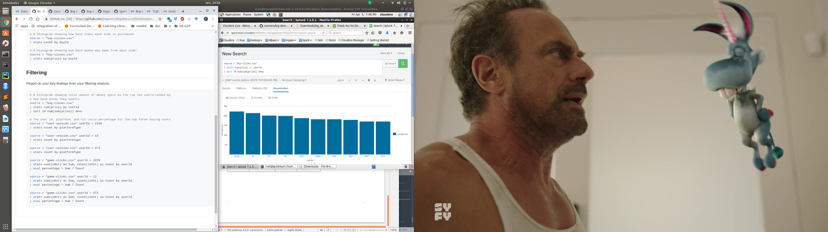
Data Exploration Overview
The data exploration was performed on Splunk using the flamingo-data, some of the results are presented below:
Histogram showing how many
times each item was purchased
Histogram showing how much
money was made from each item
Histogram showing total
amount of money spent by the top
ten users
Notes:
The data exploration provided some insights
The product 2 is selling more than the others
The product 6 even being the third most sold generates three times more revenue than the others
The top 10 users that spent more money demonstrates that the rate of spent is sustainable to the business

Slide 4
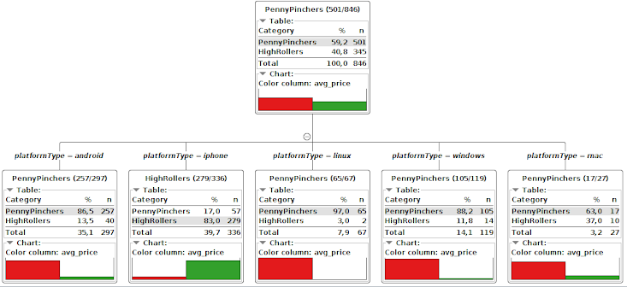
What have we learned from classification?
The classification was performed using KNIME with the method of decision trees, the threshold used was if the user bought items of 5 dollars or less and more than 5 dollars. As a result, it can be affirmed that users that perform purchases of 5 dollars of more use Iphone as presented below.
Notes:
In order to perform the classification the it was created a new variable, composed of two factors: users that bought items of 5 dollars or less and more than 5 dollars.
The tree algorithm has used the platform to classify the users and the result was that Iphone users have a tendency to spend more when compared with other platforms.

Slide 5
What have we learned from clustering?
The clustering was performed using Spark, three groups were identified and the following variables were used in the analysis:
revenue: total amount of money spent by user;
gameClickSum: sum of clicks are understood as engagement, amount by user;
adClickSum: sum of clicks are understood as the chance of purchase by user.
Cluster | adClickSum | gameClickSum | revenue
1 | 25.14 | 362.5 | 35.36
2 | 32.05 | 2393.95 | 41.2
3 | 36.47 | 953.82 | 46.16
Low level spenders
Medium Level spenders
High level spenders
Notes:
To perform the clustering three variables were selected:
revenue: total amount of money spent by user;
gameClickSum: sum of clicks are understood as engagement, amount by user;
adClickSum: sum of clicks are understood as the chance of purchase by user.
3 clusters were created:
Low level spenders
Medium Level spenders
High level spenders

Slide 6
From our chat graph analysis, what further exploration should we undertake?
This final part of the project was performed using Neo4J, based on the chat-data datasets. The following questions were proposed by the course to guide the analysis:
UserID | ChatCount
394 | 115
2067 | 111
209 | 109
Find the most chat active users.
TeamID | ChatCount
82 | 1324
185 | 1036
112 | 957
Find the most chat active teams.
UserID | Coefficient
209 | 0,95
554 | 0,9
1087 | 0,8
How active are groups of users?
Notes:
When performing the graph analysis, three questions were answered:
Which were the most chat active users?
Which were the most chat active teams?
How active are groups of users?

Slide 7
Recommendation
Android and Windows platform users are a representative part of the total of users so it makes sense invest on marketing and development to improve the turnover of sales on this group.
Due to the high spending of the Iphone users, it worths invest on marketing to bring more users of this platform.
Provide low rate fix pay for small advantages to promote low level spending groups.
Notes:
Considering all the steps performed on this project I can give three recommendations that could improve the revenue and game engagement.
Android and Windows platform users are a representative part of the total of users so it makes sense invest on marketing and development to improve the turnover of sales on this group.
Due to the high spending of the Iphone users, it worths invest on marketing to bring more users of this platform.
Provide low rate fix pay for small advantages to promote low level spending groups.

